Slide 1

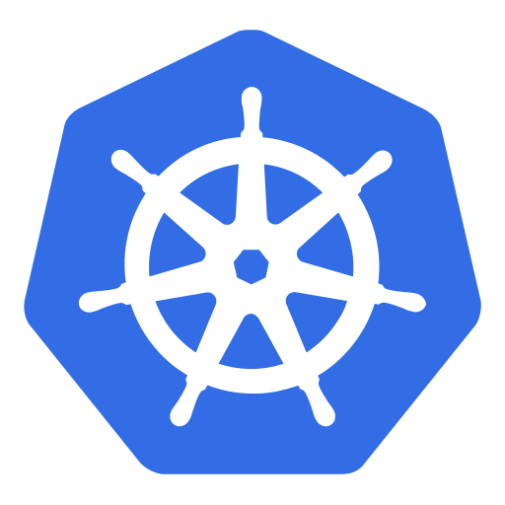
Installing Docker and Kubernetes on Raspberry PI

